Slide 1
Applying for PPE at Oxford
Mr Startup

Slide 2
Plan for today
  What is the course?
  Where can you study it?
  Who does it suit?
  What does it lead to?
  What do you need to apply?
  The TSA
  Preparations
  Any questions?

Slide 3
The three components
 | Politics | Philosophy | Economics
 | The study of the use of government power to achieve social objectives. | The study of the fundamental nature of the universe, society, language, and values. | The study of how societies allocate scarce resources between competing needs.
Core modules | Political Theory Modern political history | Ethics History of Philosophy | Macroeconomics Microeconomics
Skills needed | Historical and cultural awareness. Statistics & Data interpretation Ability to understand complex texts. | Logic. Precision in language use. Ability to understand complex texts. | Mathematics. Statistics &Data interpretation. Ability to understand complex texts.

Slide 4
Why study them together?
Many complex issues have philosophical, political and economic dimensions that interact e.g.
Longevity:
  Philosophy: Is a long life more meaningful than a short one?
  Politics: Is longevity an important political objective? How do ageing societies affect voting behaviour?
  Economics: What are the implications of an ageing society for the provision of pensions and healthcare?

Slide 5
Where can you study it?
Oxford (Not Cambridge!)
LSE
UCL
Durham
Warwick
See UCAS website for full list of universities that offer it

Slide 6
Oxford PPE – what’s it actually like?
Teaching via lectures and weekly tutorials (with one or two other students)
Hard work: 2 essays or assignments per week, every week is the norm.
Students often involved in politics, journalism, debating as well
Prelims in first year
In second and third year, huge choice of options to choose from
Can drop from 3 to 2 if you wish
Assessed entirely in 8 written exams at the end of the third year

Slide 7
Who does it suit?
Students who are wide-ranging (good at maths, science and/or humanities), who are interested in “big ideas” and enjoy debate and argument.
Those who are comfortable with complex issues that are often difficult / impossible to resolve, where there are strong arguments on both sides.
Those who can read complex, sometimes arcane, texts and grasp difficult ideas quickly.
Those who like writing.

Slide 8
Pros and cons
Advantages
Variety and interest
Ability to analyse, evaluate and present complex ideas - great skills for many careers
Graduates are sought after and often work in finance, law, consulting, politics.
Disadvantages
Workload is heavy (2 essays per week during term + collections)
Non-specialism means you will probably have knowledge that is not as deep as single honours students
You may need to do post-grad or further training for specific careers.

Slide 9


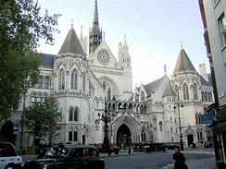
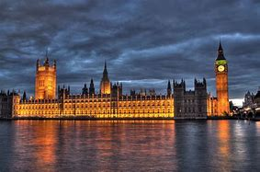



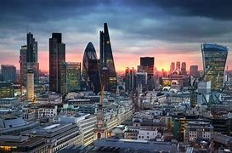

What does it lead to?

Slide 10
What do you need to study to apply for it?
No particular A levels required.
Maths highly recommended (probably necessary) – 96% of offer holders have it.
History (46%), Economics (58%), Politics, Further Maths useful but not necessary
Many people do PPE without having done any of the three before!
Typical Offer: AAA
BUT: Typical Offer Holder gets: A*A*A*
https://www.ppe.ox.ac.uk/sitefiles/ppe-admissions-2023-24-further-statistics-final.pdf

Slide 11
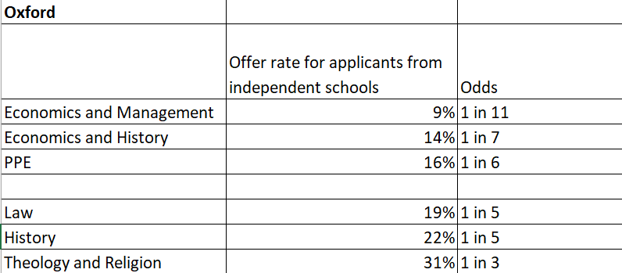
How hard to get in?
Last year, 13%, 1 in 8
Interviewed: 38%; Successful: 12%; Intake: 229 (3-year average 2022-24).
Data from official Oxford University statistics, using totals from 2018-2020

Slide 12
The TSA
For Oxford PPE admissions everyone has to sit the Thinking Skills Assessment (TSA) in October 2025
It is a test of logical and mathematical reasoning.
Two parts 1) 50 multiple choice questions (90 minutes); 2) a writing task (30 minutes).
Those who do well enough on the test, combined with other relevant academic info, will be invited to an interview.
Wycombe Abbey runs weekly sessions on this in the Autumn term (Mr Davies).
School also offers mock interviews and feedback

Slide 13
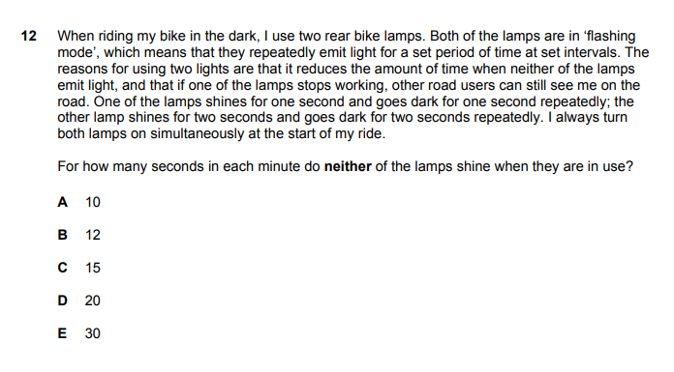
Example q

Slide 14
Preparations
Extra-curricular activities where you can discuss and debate outside syllabus.
TSA practice see: TSA (Thinking Skills Assessment) | University of Oxford
Reading to get you thinking (see end).

Slide 15
Some suggested reading
Philosophy:
  Think by Simon Blackburn
  The Problems of Philosophy, Bertrand Russell
  Meditations on First Philosophy, Rene Descartes
Politics
  What money can’t buy, Michael Sandel
  On Liberty, J.S. Mill
  The Communist Manifesto, Karl Marx
Economics
  The Undercover Economist, Tim Harford
  Intermediate Microeconomics, Hal Varian
Don’t worry if you find them hard or don’t finish them.
Make notes of your thoughts and ideas as you read.
Follow your interests.

